Slide 1
Artificial Intelligence
Sebastian Golshani – Abdirizak Jamal

Slide 2
Topic
Sheep & Dog

Slide 3
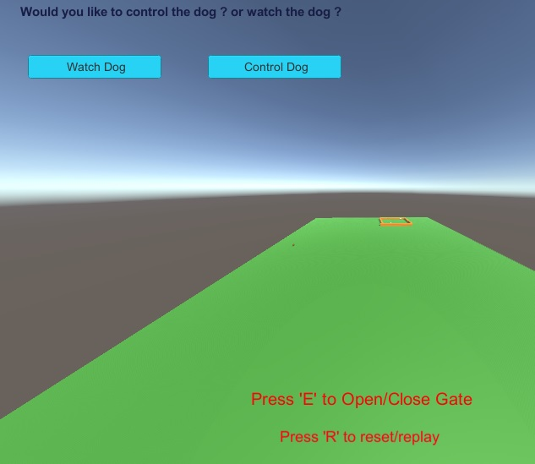
Choices
The user can control the dog
The user can watch the dog

Slide 4
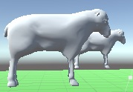
Sheep
Flees the dog, by going to the opposite direction the dog is coming from
The sheep doesn’t flee if the dog is far away

Slide 5
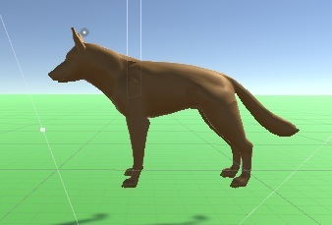
Dog
The dog can be user controlled
The AI dog finds the -angle of the furthest sheep away from the goal
The AI dog pursues to that angle

Slide 6
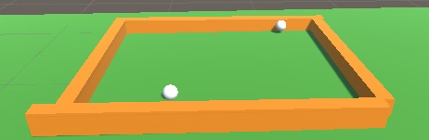
Goal (Gate)
The has a gate which opens and closes, the user can control this or it can be done automatically when the last sheep in the passes the point next to the gate.
The other point (goal), works by getting the distance of the furthest sheep away which is the sheep that the dog chases

Slide 7
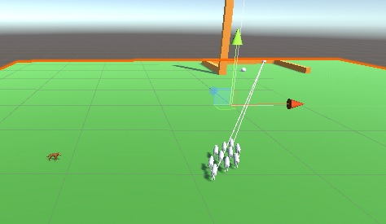
Example
So theres lines drawn to show the furthest sheep and the closest sheep from the goal.
The dog targets the furthest sheep away from the goal
The sheeps follow the closest sheep to the goal
The sheeps are flocking together

